Slide 1

Area Business Coverage
By: Deekshant Wadhwa

Slide 2

Introduction
Discussion about the business problem and people who would be interested in it

Slide 3

The most important thing that we need before starting a business in an area is to get an overview of the present business in that area. We need to identify potential clients, competition and need for a business in the area. Another essential requirement is to identify business clusters too.
This data can be used to determine if a new business can be opened in an area of business clusters so that it can get a starting advantage of high visitor foot count. Hence this data can be accumulated by my project.
It would inform the client about potential market hubs in an area and what business is best and worst to start in those hubs in a summary manner along with a map nearby venues marked using markers and clusters marked using different colors.

Slide 4

The people interested in this project would be entrepreneurs, office managers or people looking for setting up new venues.

Slide 5
Data
The data that will be used to solve the problem and the source of the data.

Slide 6

The data required for this task is the geospatial data of nearby venues present in the area of interest. This data should be quite precise and must be continuous and updated at a high frequency. We can retrieve this data using the foursquare API by providing it with a latitude-longitude pair or a geocodable string of the area we want coverage summary.

Slide 7
Methodology
The main component of the report where discussion and description of any exploratory data analysis that was performed, any inferential statistical testing that was performed

Slide 8
DBSCAN clustering is used to segregate nearby venues into clusters. Other clustering methods like K nearest neighbors cannot be used for this task as it has to classify each venue into one cluster or another necessarily, but in this case, we need to leave out specific venues as noise as there aren’t necessary clusters forming in every area.
As we are using DBSCAN only correct clusters would be identified based on 2 hyperparameters – minimum venues present to form a cluster and maximum distance between 2 venues to be considered as a part of a cluster. ‘sklearn’ is used to perform DBSCAN clustering, ‘folium’ is used to create and mark maps, data is extracted using the ‘foursquare’ API to which a pair of latitude-longitude or a geocodable string is passed.
The user provides this input and the code returns a map congaing nearby venues and clusters marked using different colors along with a summary of venue name and category of all venues of all clusters (and venues not a part of any cluster). The rest of the data handling and manipulation is done using the pandas library. The data is concise and summarized into a table of several clusters and a section containing the venues which are not a part of any cluster. The number of nearby venues can be increased by upgrading the ‘foursquare’ API.

Slide 9
Result
Result discussion

Slide 10

The result of this project is a concise summary of nearby areas in a tabular and graphical manner segregated based upon various clusters. The clusters can be varied based upon the area selected, minimum distance and minimum number of venues to be considered to become a cluster

Slide 11
Conclusion
Report Conclusion

Slide 12
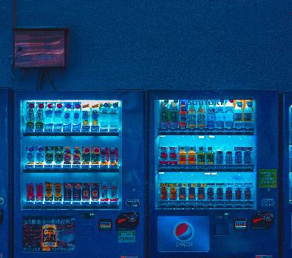
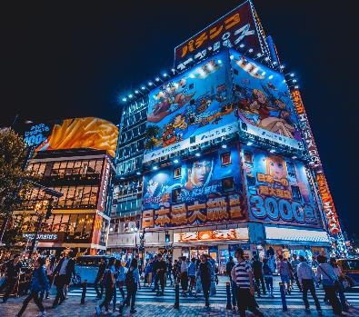

Nearby venues can be clustered for an area to determine potential venue hubs and potential business opportunities. This type of venue summary is required to be studied to understand the venue distribution in an area such that if one kind of a venue is shared inside a cluster or uncommon outside the cluster, the category of venues can become future potential business there.

Slide 13
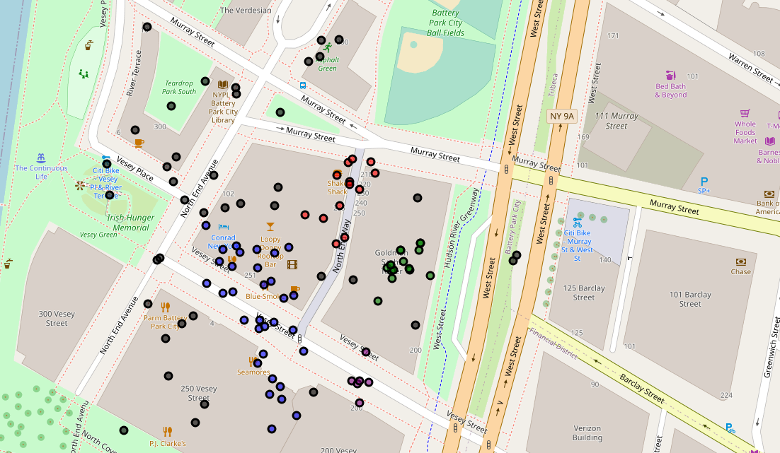
Output Map

Slide 14
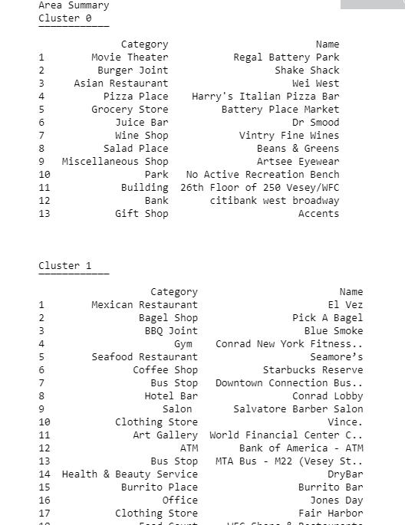
Summary Table

Slide 15




Thank You
Deekshant Wadhwa
www.s2scart.com
deekshantwadhwa2000@gmail.com
https://github.com/deekshant-w/Coursera_Capstone

